Slide 1
Systems Analysis and Design 9th Edition
Chapter 1
Introduction to Systems Analysis and Design

Slide 2
Chapter Objectives
Discuss the impact of information technology on business strategy and success
Define an information system and describe its components
Explain how profiles and models can represent business functions and operations
Explain how the Internet has affected business strategies and relationships
Identify various types of information systems and explain who uses them

Slide 3
Chapter Objectives
Distinguish between structured analysis, object-oriented analysis, and agile methods
Compare the traditional waterfall model with agile methods and models
Apply five basic guidelines for systems development
Discuss the role of the information technology department and the systems analysts who work there

Slide 4
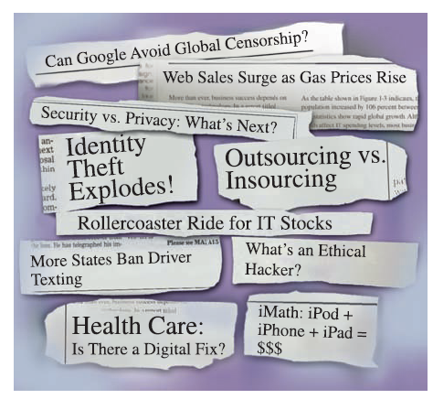
Introduction
Companies use information as a weapon in the battle to increase productivity, deliver quality products and services, maintain customer loyalty, and make sound decisions
Information technology can mean the difference between success and failure

Slide 5
The Impact of Information Technology
Information Technology (IT)
Combination of hardware and software products and services that companies use to manage, access, communicate, and share information
The Future
Three issues that will shape the future
Changes in world
Changes in technology
Changes in client demand

Slide 6
The Impact of Information Technology
Systems Development
Business information systems are developed by people who are technically qualified, business-oriented, and highly motivated
Must be good communicators with strong analytical and critical thinking skills

Slide 7
The Impact of Information Technology
Systems Analysis and Design
Systems Analysis and Design
Step-by-step process for developing high-quality information systems
Systems Analyst
Plan, develop, and maintain information systems

Slide 8
The Impact of Information Technology
Who develops Information Systems?
In-house applications
Software packages
Internet-based application services
Outsourcing
Custom solutions
Enterprise-wide software strategies
How versus What

Slide 9
Information System Components
A system is a set of related components that produces specific results
A Mission-critical system is one that is vital to a company’s operations
Data consists of basic facts that are the system’s raw material
Information is data that has been transformed into output that is valuable to users
Information systems have five key components: hardware, software, data, processes, and people

Slide 10
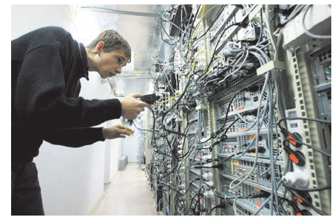
Information System Components
Hardware
Is the physical layer of the information system
Moore’s Law
Software
System software
Application software
Enterprise applications

Slide 11
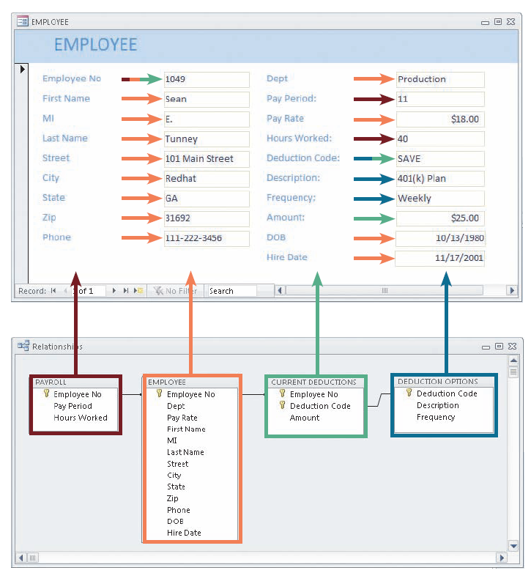
Information System Components
Software
Horizontal system
Vertical system
Legacy systems
Data
Tables store data
Linked tables work together to supply data

Slide 12
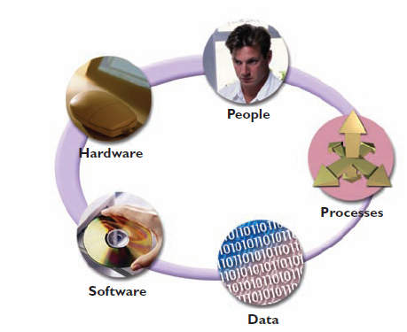
Information System Components
Processes
Describe the tasks and business functions that users, managers, and IT staff members perform to achieve specific results
People
Stakeholders
Users, or end users

Slide 13
Understanding The Business
Business Process Modeling
Business Profile
Business Models
Business model
Business process
Business process reengineering (BPR)

Slide 14
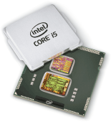
Understanding The Business
New Kinds of Companies
Production-oriented
Service-oriented
Internet-dependent
Dot-com (.com)
Brick-and-mortar

Slide 15
Impact of the Internet
E-Commerce or I-Commerce
B2C (Business-to-Consumer)
B2B (Business-to-Business)
EDI
Extensible markup language (XML)
Supply chain management (SCM)
Supplier relationship management (SRM)

Slide 16
Business Information Systems
In the past, IT managers divided systems into categories based on the user group the system served
Office systems
Operational systems
Decision support systems
Executive information systems

Slide 17
Business Information Systems
Today, identify a system by its functions and features, rather than by its users
Enterprise computing systems
Transaction processing systems
Business support systems
Knowledge management systems
User productivity systems

Slide 18
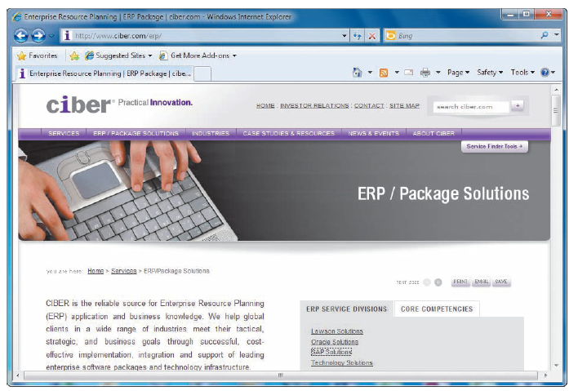
Business Information Systems
Enterprise computing systems
Support company-wide operations and data management requirements
Enterprise resource planning (ERP)
Many hardware and software vendors target the enterprise computing market

Slide 19
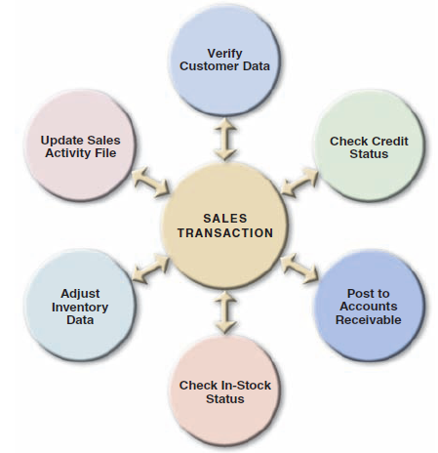
Business Information Systems
Transaction processing systems
Involve large amounts of data and are mission-critical systems
Efficient because they process a set of transaction-related commands as a group rather than individually

Slide 20
Business Information Systems
Business support systems
Provide job-related information to users at all levels of a company
Management information systems (MIS)
Radio frequency identification (RFID)
What-if

Slide 21
Business Information Systems
Knowledge management systems
Called expert systems
Simulate human reasoning by combining a knowledge base and inference rules
Many knowledge management systems use a technique called fuzzy logic

Slide 22
Business Information Systems
User productivity systems
Technology that improves productivity
Groupware
Information systems integration
Most large companies require systems that combine transaction processing, business support, knowledge management, and user productivity features

Slide 23
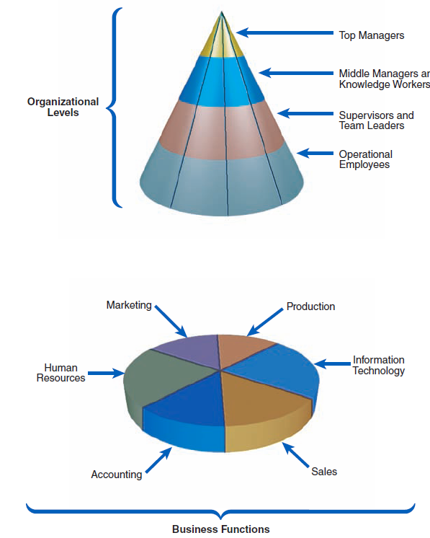
What Information Do Users Need?

Slide 24
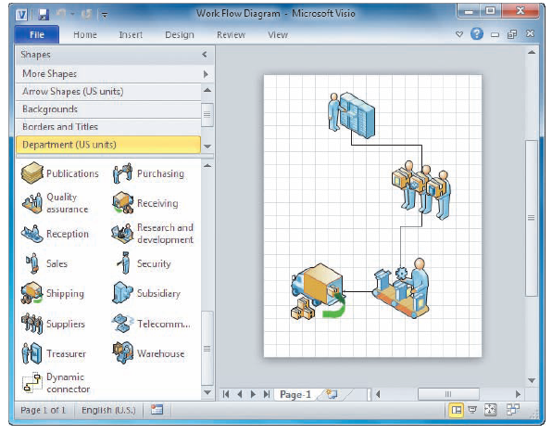
Systems Development Tools
Modeling
Business model
Requirements model
Data model
Object model
Network model
Process model

Slide 25
Systems Development Tools
Prototyping
Prototype
Speeds up the development process significantly
Important decisions might be made too early, before business or IT issues are thoroughly understood
Can be an extremely valuable tool

Slide 26
Systems Development Tools
Computer-Aided Systems Engineering (CASE) Tools
Also called computer-aided software engineering
CASE tools
Can generate program code, which speeds the implementation process

Slide 27
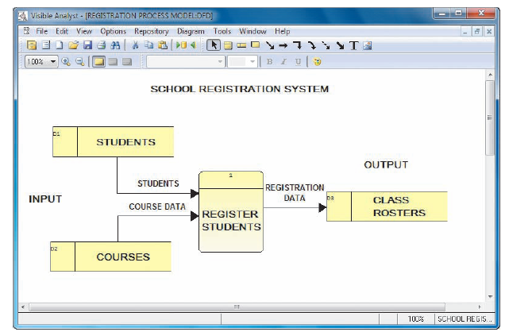
Systems Development Methods
Structured Analysis
Systems development life cycle (SDLC)
Predictive approach
Uses a set of process models to describe a system graphically
Process-centered technique
Waterfall model

Slide 28
Systems Development Methods
Structured Analysis
Deliverable or end product
Disadvantage in the built-in structure of the SDLC, because the waterfall model does not emphasize interactivity among the phases
This criticism can be valid if the SDLC phases are followed too rigidly
Adjacent phases usually interact

Slide 29
Systems Development Methods
Structured Analysis
The SDLC model usually includes five steps
Systems planning
Systems analysis
Systems design
Systems implementation
Systems support and security

Slide 30
Systems Development Methods
Structured Analysis
Systems Planning
Systems planning phase
Systems request – begins the process & describes problems or desired changes
Purpose of this phase is to perform a preliminary investigation
Key part of preliminary investigation is a feasibility study

Slide 31
Systems Development Methods
Structured Analysis
Systems Analysis
Deliverable is the System requirements document
Systems Design
Deliverable is system design specification
Management and user involvement is critical

Slide 32
Systems Development Methods
Structured Analysis
Systems Implementation
New system is constructed
Systems Support and Security
A well-designed system must be secure, reliable, maintainable, and scalable
Most information systems need to be updated significantly or replaced after several years of operation

Slide 33
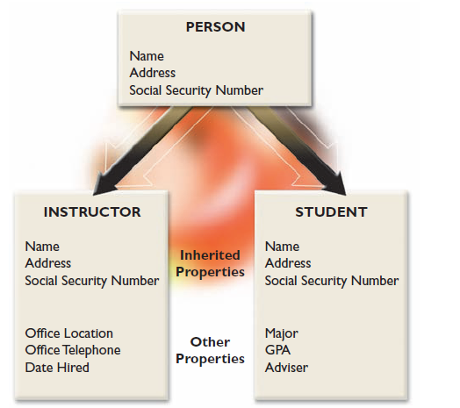
Systems Development Methods
Object-oriented Analysis
Combines data & processes that act on the data into things called objects
Object is a member of a class
Objects possess properties
Methods change an object’s properties

Slide 34
Systems Development Methods
Object-Oriented Analysis
A message requests specific behavior or information from another object
Usually follow a series of analysis and design phases that are similar to the SDLC
Interactive model

Slide 35
Systems Development Methods
Agile Methods
Are the newest development
Emphasize continuous feedback
Iterative development
Agile community has published the Agile Manifesto
Spiral model

Slide 36
Systems Development Methods
Agile Methods
Agile process determines the end result
Other adaptive variations and related methods exist
Two examples are Scrum and Extreme Programming (XP)
Analysts should understand the pros and cons of any approach before selecting a development method

Slide 37
Systems Development Methods
Other Development Methods
Joint application development (JAD)
Rapid application development (RAD)
Might encounter other systems development techniques
Rational Unified Process (RUP®)
Microsoft Solutions Framework (MSF)

Slide 38
Systems Development Guidelines
Develop a project plan
Involve users and listen carefully to them
Use project management tools to identify tasks and milestones
Develop accurate cost and benefit information
Remain flexible

Slide 39
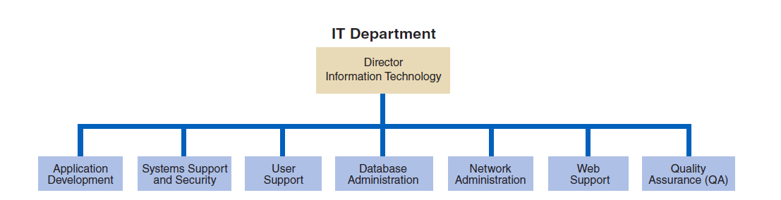
Information Technology Department

Slide 40
The Systems Analyst
Responsibilities
Translate business requirements into IT projects
Knowledge, Skills, and Education
Needs technical knowledge, strong oral and written communication skills and analytic ability, an understanding of business operations, and critical thinking skills
Certification
Important credential

Slide 41
The Systems Analyst
Career Opportunities
Job titles
Company organization
Company size
Corporate culture
Salary, location, and future growth

Slide 42
Chapter Summary
IT refers to the combination of hardware and software resources that companies use to manage, access, communicate, and share information
The essential components of an information system are hardware, software, data, processes, and people
Successful companies offer a mix of products, technical and financial services, consulting, and customer support

Slide 43
Chapter Summary
Information systems are identified as enterprise computing systems, transaction processing systems, business support systems, knowledge management systems, or user productivity systems
Organization structure includes top managers, middle managers and knowledge workers, supervisors and team leaders

Slide 44
Chapter Summary
The IT department develops, maintains and operates a company’s information systems
Systems analysts need a combination of technical and business knowledge, analytical ability, and communication skills
Systems analysts need to consider salary, location, and future growth potential when making a career decision

Slide 45
Chapter Summary
Chapter 1 complete

